Slide 1
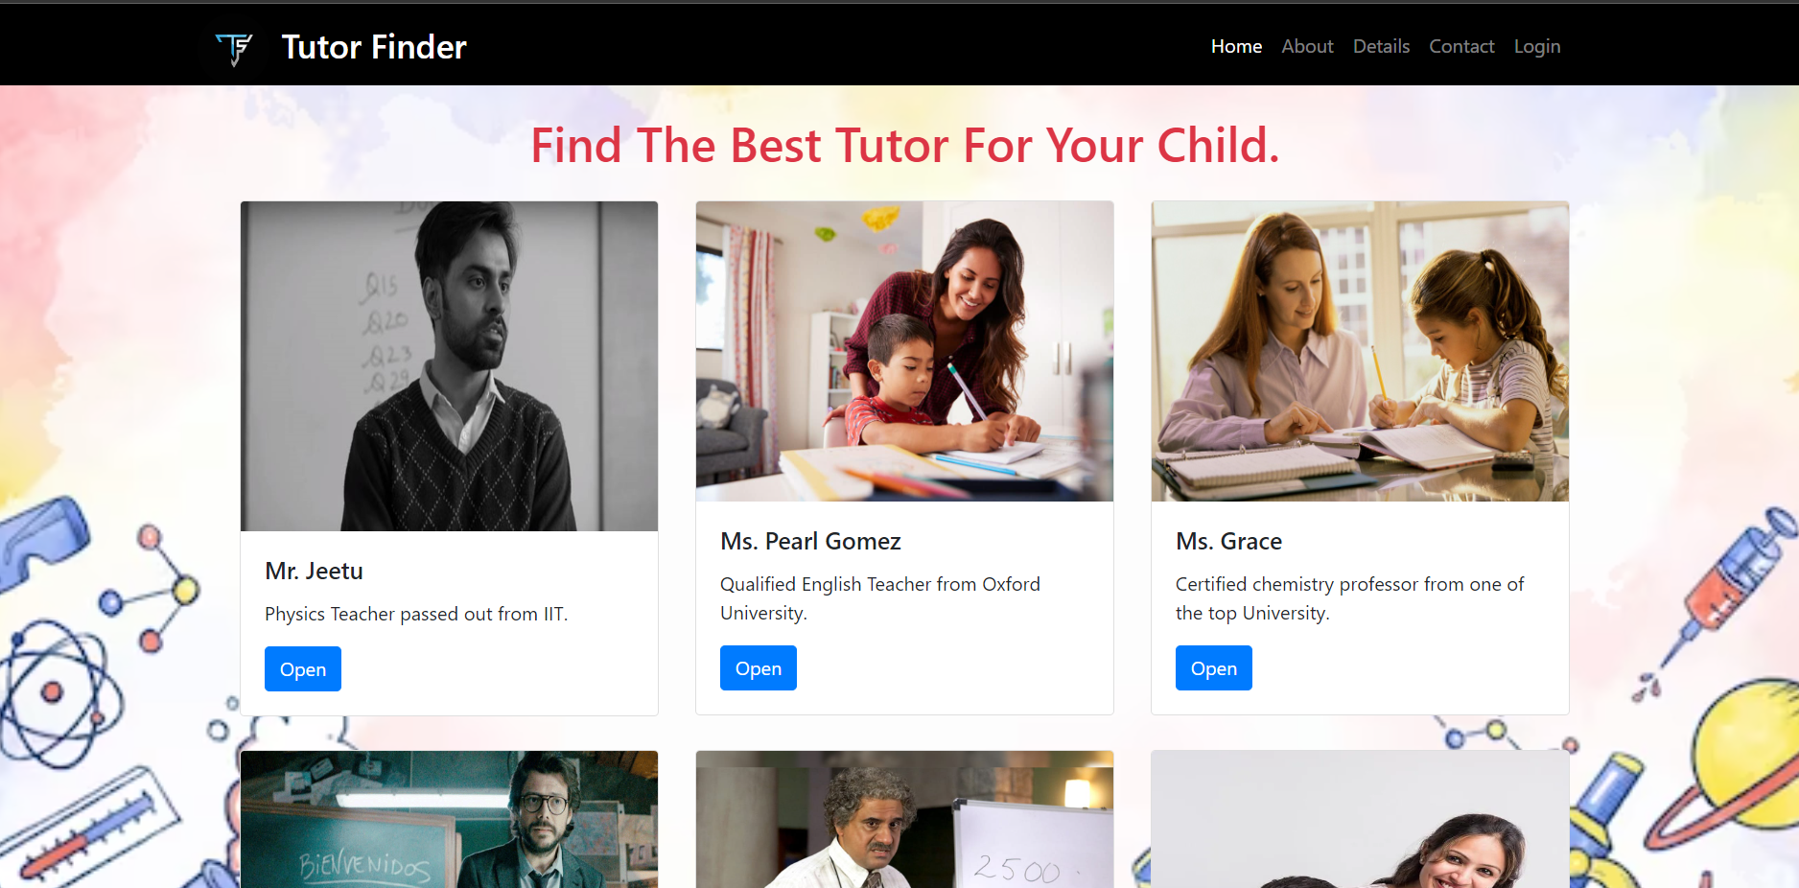
Nikhil Sharma
2010990882
G 11

Slide 2
Content
1.Acknowlegdement.............................................................
2.Abstraction.......................................................................
3.Introduction......................................................................
4.Pages...............................................................................
4.1.Home.........................................................................
4.2.About........................................................................
4.3 Contact..............................................................
5.Conclusion........................................................................
6.Bibliography.....................................................................

Slide 3
Acknowledgement
First and foremost, we would like to thank our Teacher Mr.Anupinder who
guided us in doing this project. He provided us with invaluable advice. His
motivation and help contributed tremendously to the successful completion of
the project.
Besides, thanks to all who helped in giving all the advice and
providing the equipment which was needed.
Also, we would like to thank our family members and friends for their support.
Without their support, we couldn’t have succeeded in completing this project.

Slide 4
Abstract
The objective of this case study is in the title “Find Tutor Website"
which is a management system to manage Customer Order Management.
The main objective for
developing this project is to manage Customers ,Payments and handling the feedback.
It can also manage daily transactions with
intake and outgoing data.
It also takes in the looks after the respect and peaceful service provided to the customers.
The feedbacks are taken into consideration.

Slide 5
Introduction
React is a declarative, efficient, and flexible JavaScript library for building user interfaces.
React uses a declarative paradigm that makes it easier to reason about your application and aims to be both efficient and flexible. It designs simple views for each state in your application, and React will efficiently update and render just the right component when your data changes. The declarative view makes your code more predictable and easier to debug.
React creates a VIRTUAL DOM in memory.
Instead of manipulating the browser's DOM directly, React creates a virtual DOM in memory, where it does all the necessary manipulating, before making the changes in the browser DOM.

Slide 6
Home Page
Home Page: Here the page start with the nav bar on the top that has been created using the HTML nav tag.
Then we have used various div to place the images which have being implied with the CSS
animation fade In-left/right .
In the end we have used flexbox containers to store images, on which we have used CSS property of hover ,that is when we hover on the images the images pop out.

Slide 7
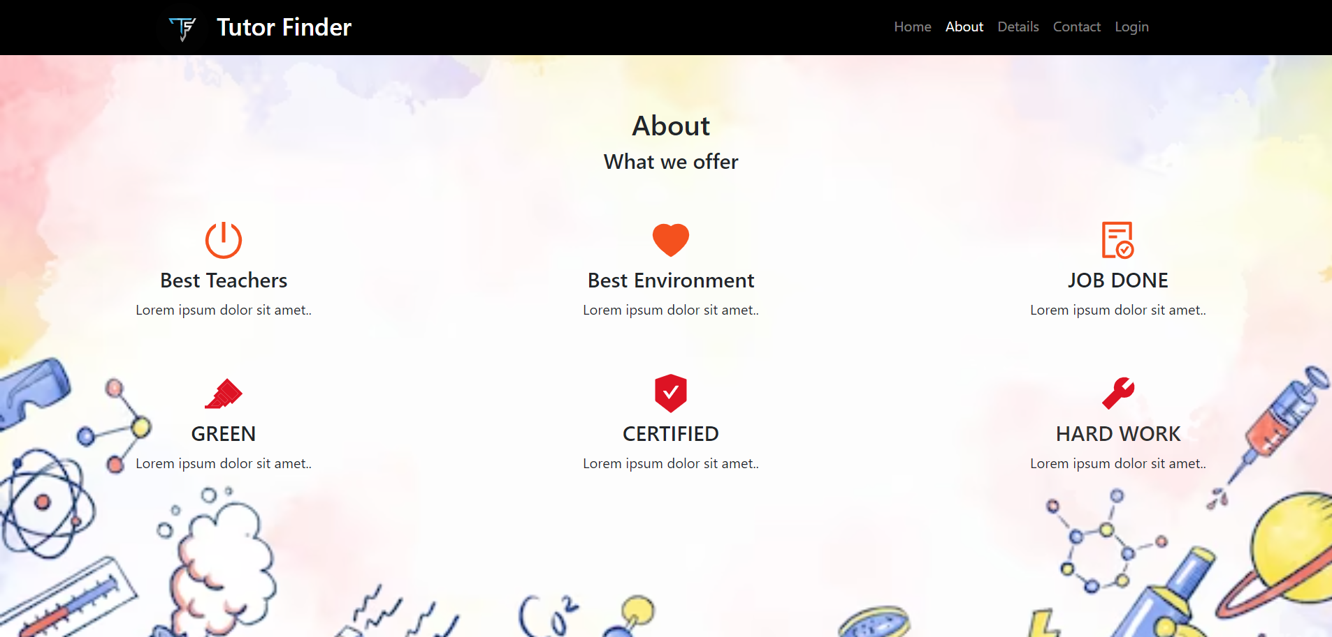
About Page
About Page: Here we have used various divs to store that text and the images which provide us with the information about the customer service we provide .

Slide 8
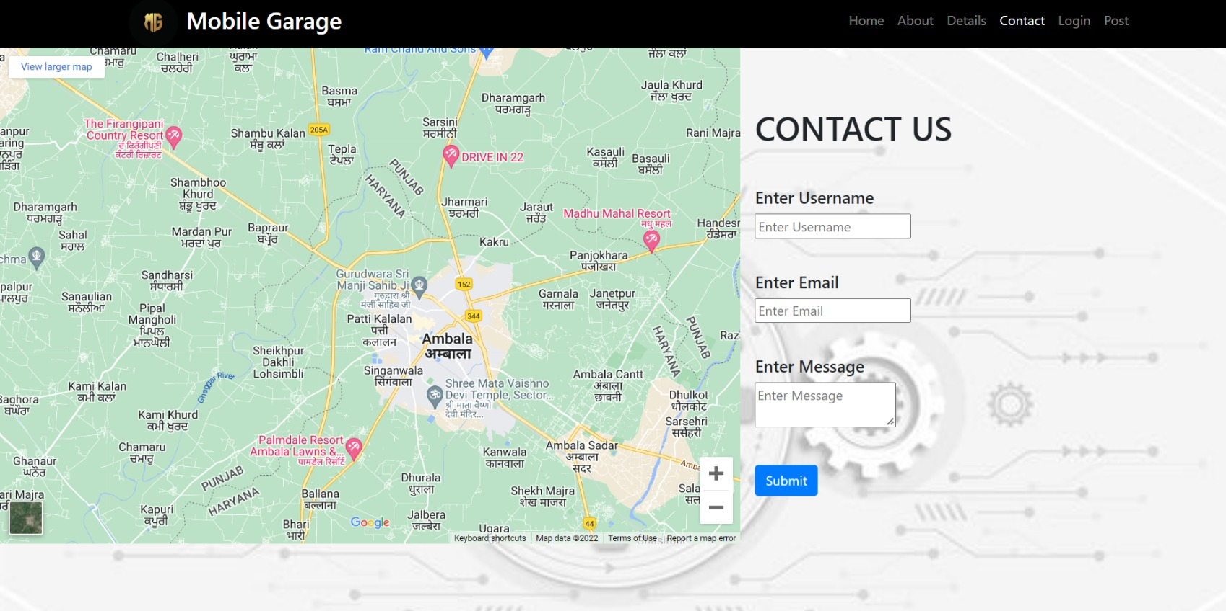
Contact Us
Contact Us: In this web page we have used gmaps to display the location ,which has been embeded from google maps.
And below we have used a form to fill , to provide feedback ,along with contact details
Of our store.

Slide 9

Conclusion
ReactJS is one of the highly used open-source JavaScript Library that helps in creating impressive web apps requiring minimal effort and coding. The key objective of ReactJS is also developing engaging User Interfaces (UI) that improves the speed of the apps.
One of the prominent factors that go in the favor of ReactJS is that it is launched by none other than the social media king Facebook. Moreover, ReactJS can render on the server using Node. The developers can also look to build native apps by employing the React Native.
React is providing the developer’s a better work experience and the advantage to change any component at any point in time without affecting the rest of the applications, resulting in widespread business support and innumerous websites built on React.

Slide 10
Bibliography
1.https://www.geeksforgeeks.org/reactjs-tutorials/
2.https://www.w3schools.com/REACT/DEFAULT.ASP
3.https://reactjs.org/
4.https://en.wikipedia.org/wiki/React_(JavaScript_library)

